Slide 1
Bezier Loiter And Orbit
Connor Guzikowski
Bailen Lawson
Miguel Tamayo
ECE 263
ECE 263 - Final Project

Slide 2
Introduction
Problem Statement
UAV’s may be used for automatic surveillance of various locations. This project aimed to implement a naive method for autonomous surveillance. Given a set of waypoints, the UAV goes to the ith waypoint, orbits for t amount of time, move to the i+1 waypoint and repeat. To make the project more interesting, we wanted to have the path between waypoints be a bezier curve.
ECE 263
ECE 263 - Final Project
Notes:
Miguel

Slide 3
Introduction
Background
The path following algorithm implements the control logic described by Beard and McLain (where the UAV is driven to follow the path described by the initial waypoint position and direction via a vector field)[1], and the virtual target point (VTL) calculation from a curve from Zhao et. al[2].
The orbiting algorithm directly implements the control logic described by Beard and McLain[1].
The Bezier logic is taken partially from a class website[3].
[1] R. W. Beard and T. W. McLain, Small unmanned aircraft: theory and practice. Princeton, N.J: Princeton University Press, 2012.
[2] S. Zhao, X. Wang, Z. Lin, D. Zhang, and L. Shen, “Integrating Vector Field Approach and Input-to-State Stability Curved Path Following for Unmanned Aerial Vehicles,” IEEE Trans. Syst. Man Cybern, Syst., pp. 1–8, 2018, doi: 10.1109/TSMC.2018.2839840.
[3] https://pages.mtu.edu/~shene/COURSES/cs3621/NOTES/spline/Bezier/bezier-der.html
ECE 263
ECE 263 - Final Project
Notes:
Bailen

Slide 4
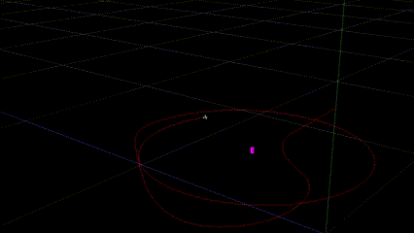
Design
Criteria for Success
Move between 3 waypoints, orbiting for a set amount of time at each waypoint in a specific direction, and successfully return to orbit the first waypoint.
ECE 263
ECE 263 - Final Project
Notes:
Connor

Slide 5
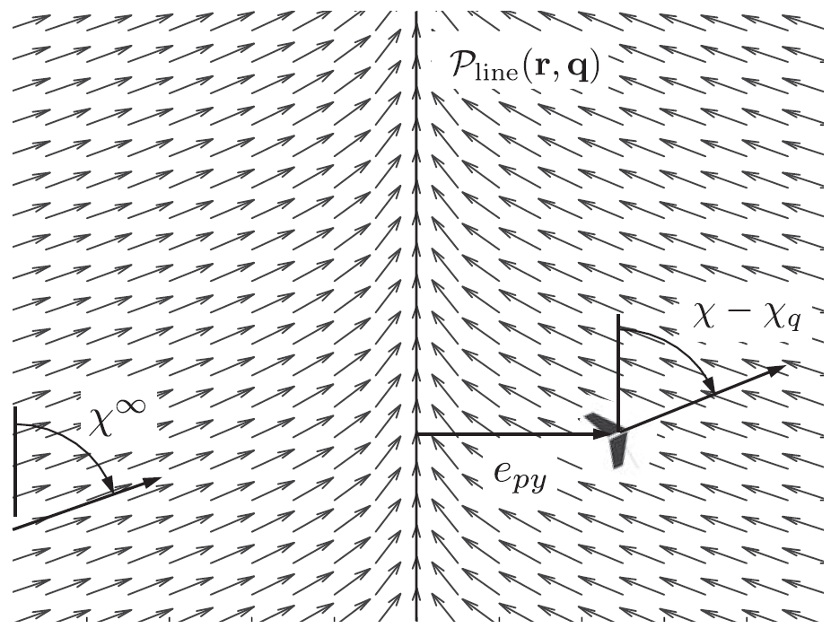
Path Following Design
Straight Line Following
Same method as book
Define start point and direction vector towards next waypoint
Far from path, move directly towards path
Close to path, move along path
Blend using arctangent.
Vector field generated by algorithm. Figure 10.3 in the book.
ECE 263
ECE 263 - Final Project
Notes:
Miguel

Slide 6
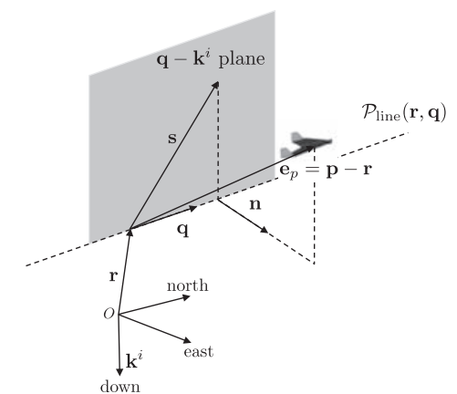
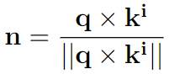
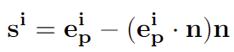
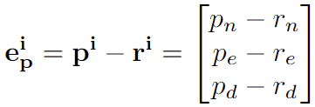
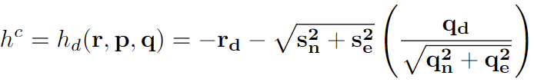
Path Following Implementation
Calculating the unit normal vector to the plane q-k
Calculating the projected error on the vertical plane
Calculating desired height
ECE 263
ECE 263 - Final Project
Notes:
Miguel:
n: normal vector for the q-k plane
e_p: error in the inertial frame this has the crosstrack error (parallel to path and
si = projected error onto the q-k plane. Used to get the commanded height

Slide 7
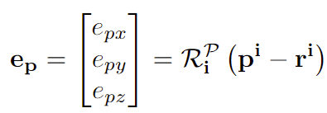
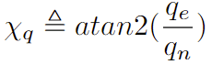
Path Following Implementation (Cont.)
Calculating path course angle for the next waypoint
Calculating the path course angle
ECE 263
ECE 263 - Final Project
Notes:
Miguel
ep: error in the path frame
xq: tells us the angle between north and the path

Slide 8
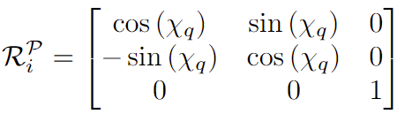
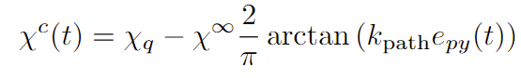
Path Following Implementation (Cont.)
Calculating Rotation matrix from inertial to path frame:
Calculating the course command from out desired path course:
Notes:
Miguel
R: rotation matrix used to calculate the error in the path plane. This is just a rotation about the z axis
chi_c: commanded course calculated to match the the course angle of the path
chi_infinity: angle at which we approach the desired path from far away
k_path: gain used for the blending (angle of approach for the paht)

Slide 9
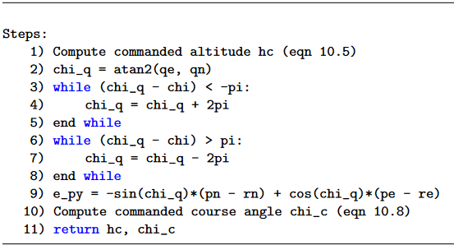
Path Following Implementation (Cont.)
Algorithm
Same method as Algorithm 4 in book
Tuning
k_path: 0.05
chi_infty: pi/2
ECE 263 - Final Project
Notes:
Miguel

Slide 10
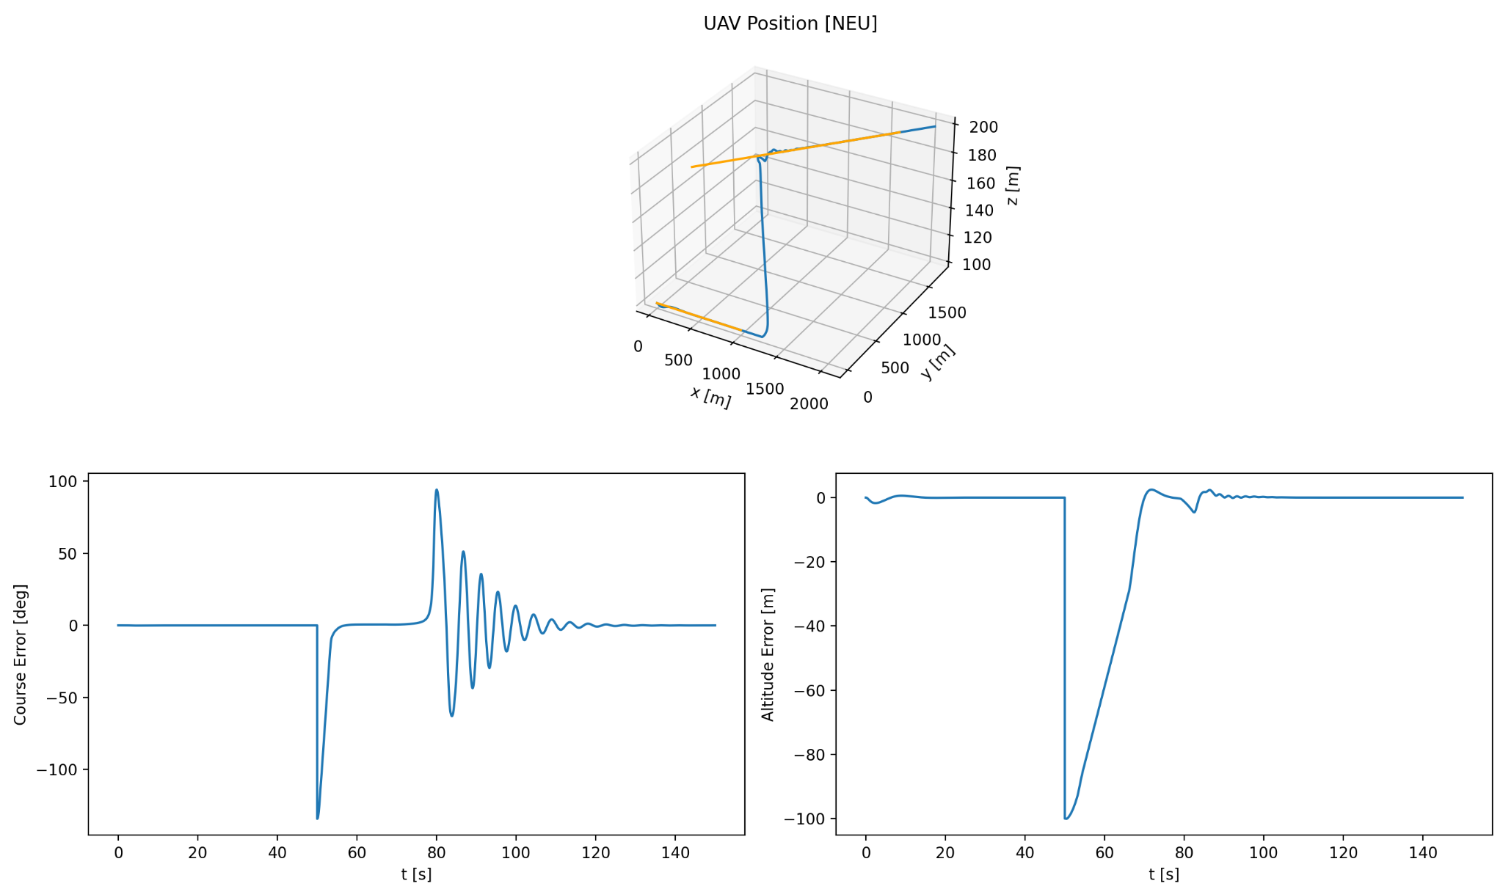
Path Following Results
ECE 263 - Final Project
Notes:
Miguel

Slide 11
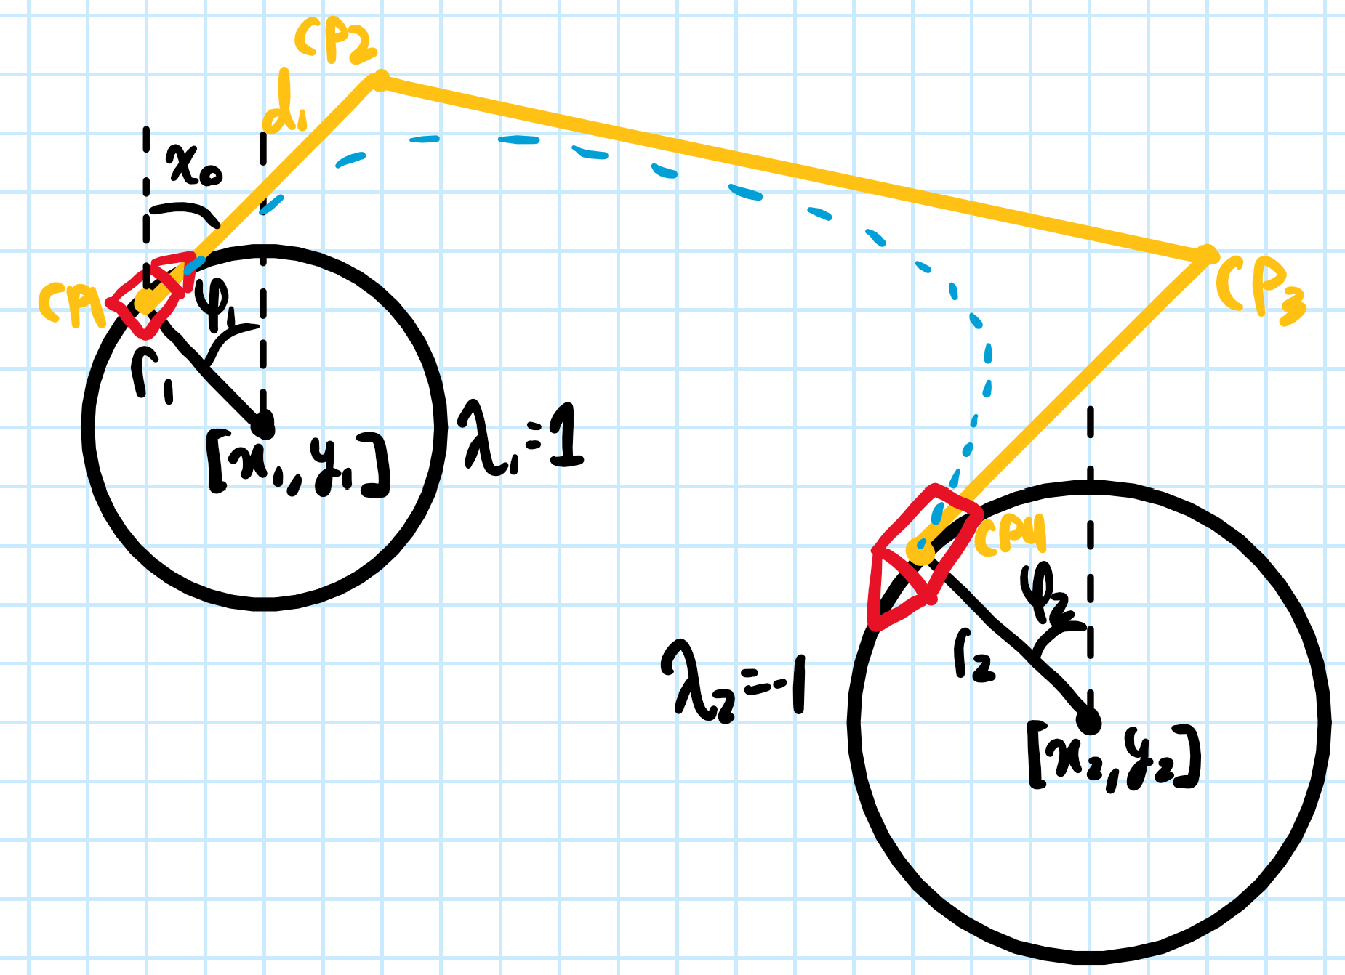
Bezier Path Following Design
Bezier Line Following
Calculate control points based on angle around current orbit waypoint.
Update origin and direction at each step to move along path and use same algorithm as straight line following.
ECE 263
ECE 263 - Final Project
Notes:
Bailen

Slide 12
Bezier Path Following Implementation
Control Points
If λ₁ ≠ λ₂, φ₂ = φ₁
If λ₁ = λ₂, φ₂ = -φ₁
d₁ = r₁ + d_{min}
d₂ = r₂ + d_{min}
χ₀ = λ₁ + π/2
R = euler2dcm(χ₀,0,0)
CP1 = [x₁ + r₁*sin(χ₀), y₁ + r₁*cos(χ₀)]
CP4 = [x₂ + r₂*sin(χ₀), y₂ + r₂*cos(χ₀)]
CP2 = CP1 + R * [d₁,0,0]^{T}
CP3 = CP4 + R * [d₂,0,0]^{T}
ECE 263
ECE 263 - Final Project
Notes:
Bailen

Slide 13
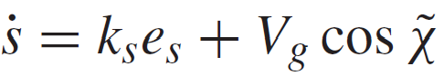
Bezier Path Following Implementation (Cont.)
Speed along curve
Bezier curve: P₀, P₁, …, P_{n}
Bezier curve derivative: n(P₁ - P₀), n(P₂ - P₁), …, n(P_{n} - P_{n-1})
Notes:
Bailen

Slide 14
Bezier Path Following Implementation (Cont.)
Bezier Addition Algorithm
Calculate speed along path
Calculate position along path
Limit position to never go backwards
Update position and direction based on bezier and bezier derivative at current position along curve
Tuning
ks: 1
k_{path} : 0.0001
ECE 263 - Final Project
Notes:
Bailen

Slide 15
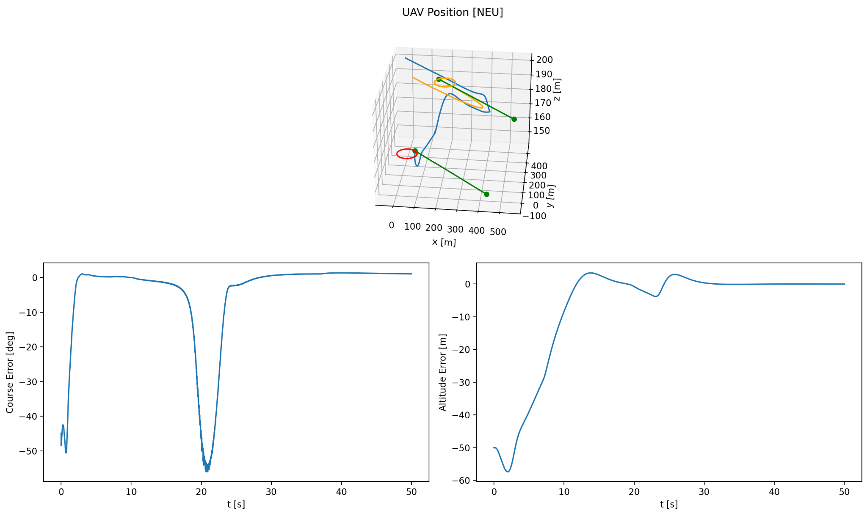
Bezier Path Following Results
ECE 263 - Final Project
Notes:
Bailen

Slide 16
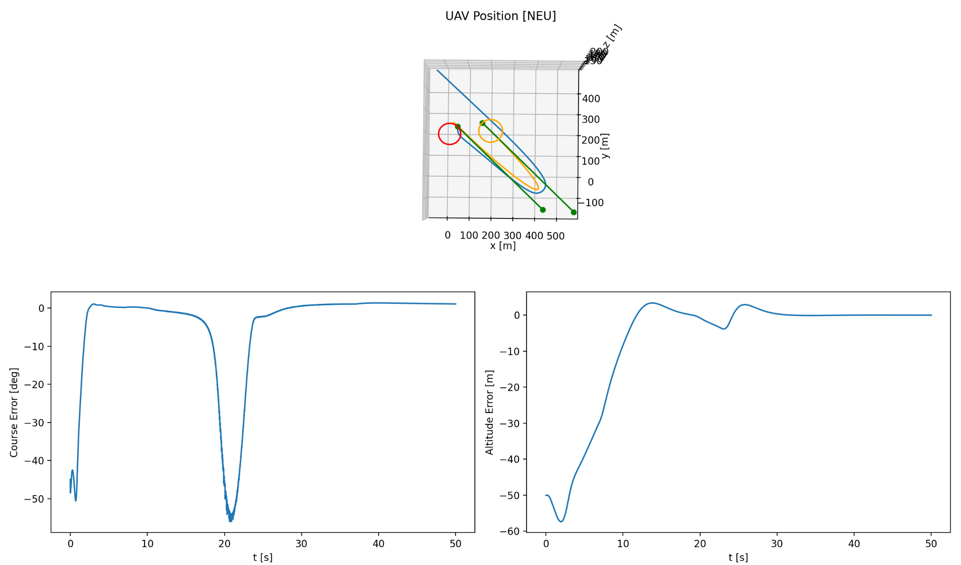
Bezier Path Following Results
ECE 263 - Final Project
Notes:
Bailen

Slide 17
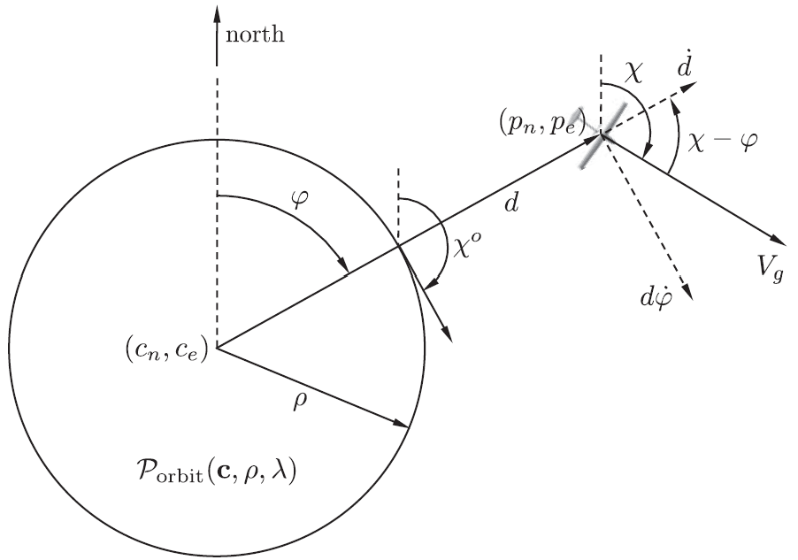
Orbiting Design
Orbiting
Same method as book
Define orbit point, radius, and direction
Far from orbit, move directly towards center
Close to path, move along orbit tangent
Blend using arctangent.
Angles and distances for orbiting. Figure 10.6 in the book.
ECE 263
ECE 263 - Final Project
Notes:
Bailen

Slide 18
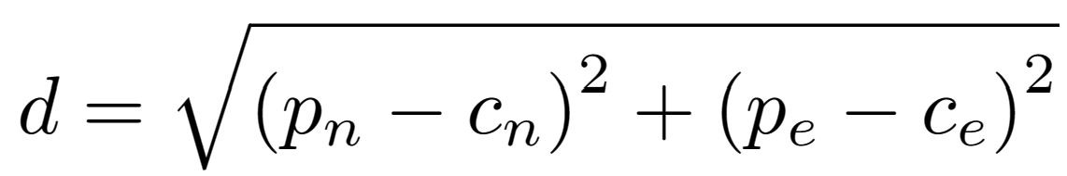
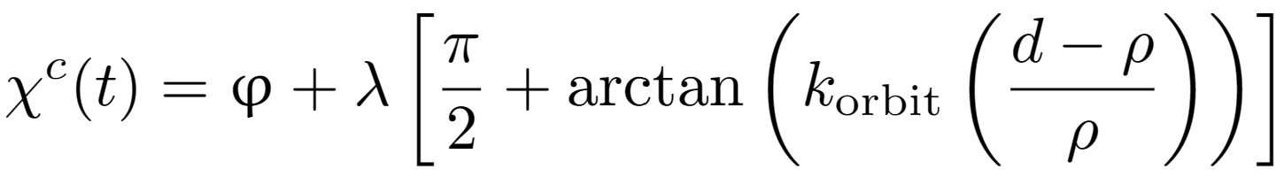
Orbiting Implementation
Distance from orbit center
Angle along orbit circle
Angle along orbit circle
ECE 263 - Final Project
Notes:
Bailen

Slide 19
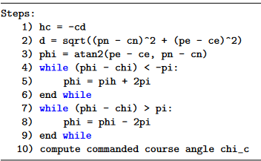
Orbiting Implementation
Algorithm
Same method as Algorithm 3 in book
Tuning
k_orbit: 1
ECE 263 - Final Project
Notes:
Bailen

Slide 20
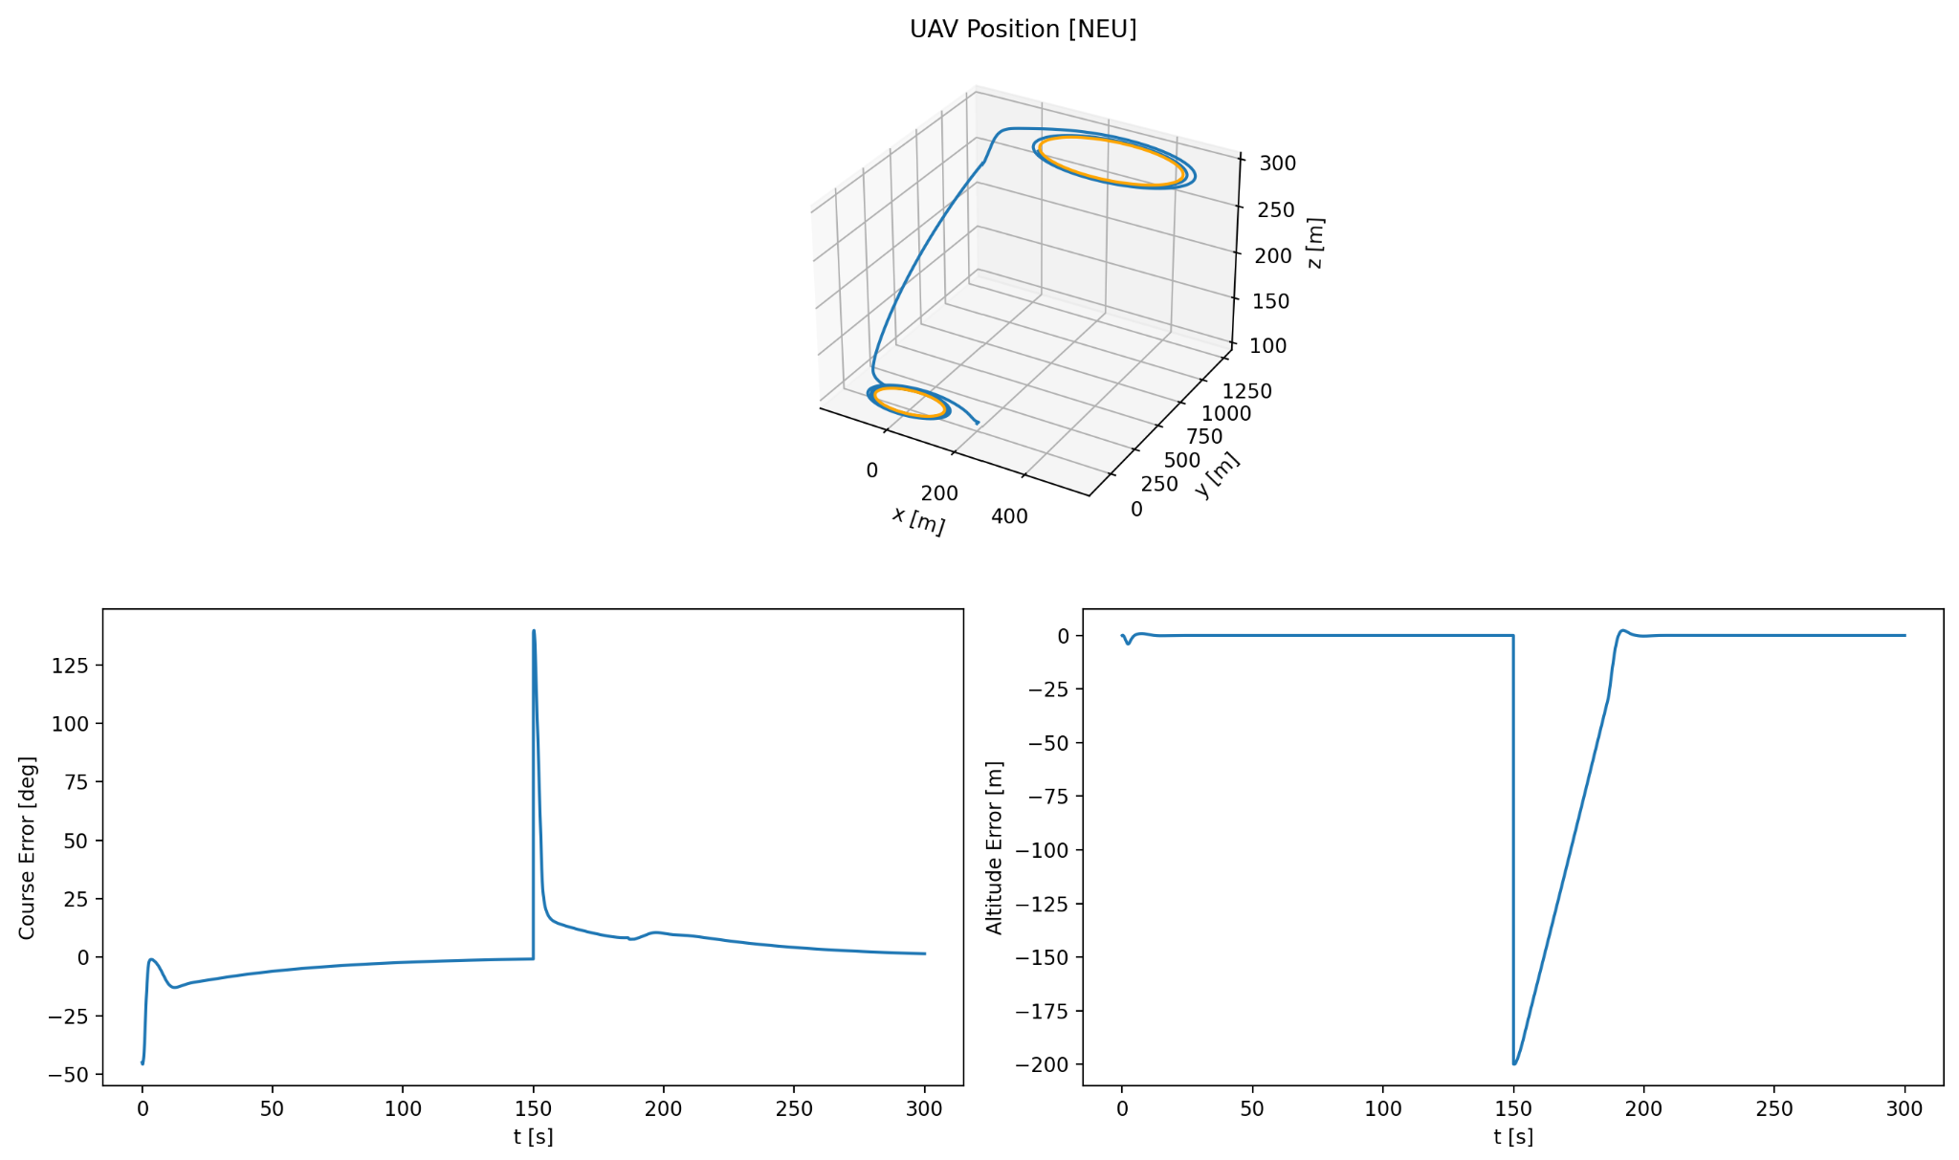
Orbiting Results
ECE 263 - Final Project
Notes:
Bailen

Slide 21
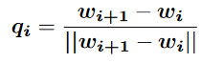
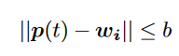
Waypoint Manager Implementation
Calculating the direction vector from one waypoint to the next:
Equation to determine if UAV is in waypoint radius or not:
ECE 263 - Final Project
Notes:
Connor

Slide 22
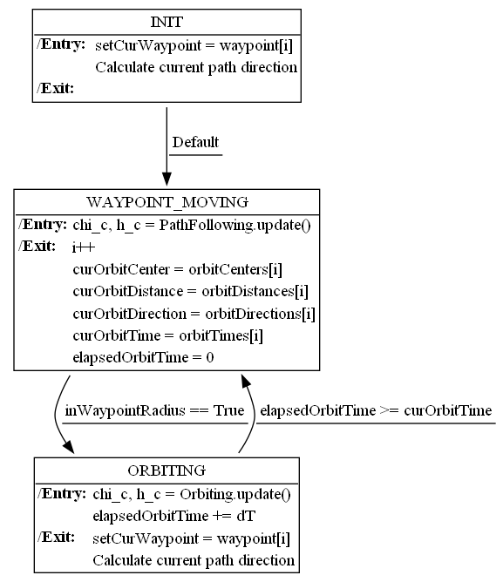
State Machine Design
ECE 263
ECE 263 - Final Project
Notes:
Connor

Slide 23
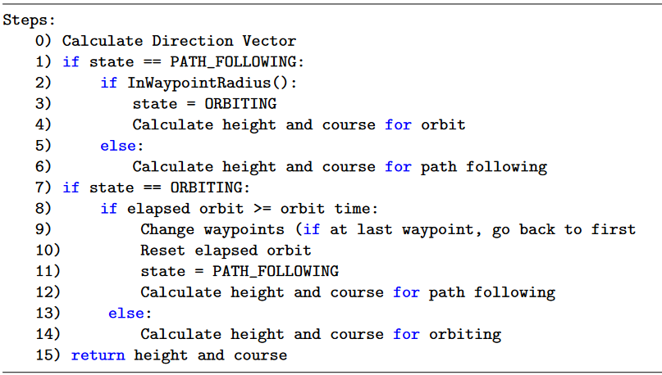
Waypoint Manager Implementation
ECE 263 - Final Project
Notes:
Connor

Slide 24
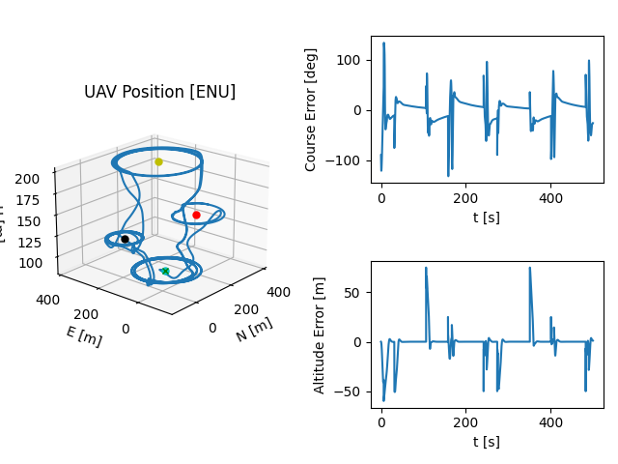
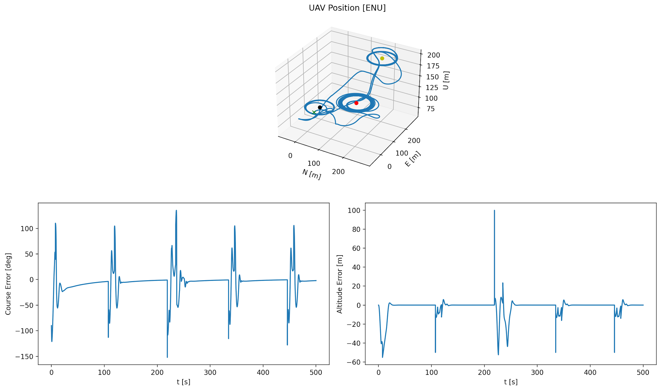
Waypoint Manager Results
Bezier curve following.
Straight line following.
ECE 263 - Final Project
Notes:
Connor

Slide 25
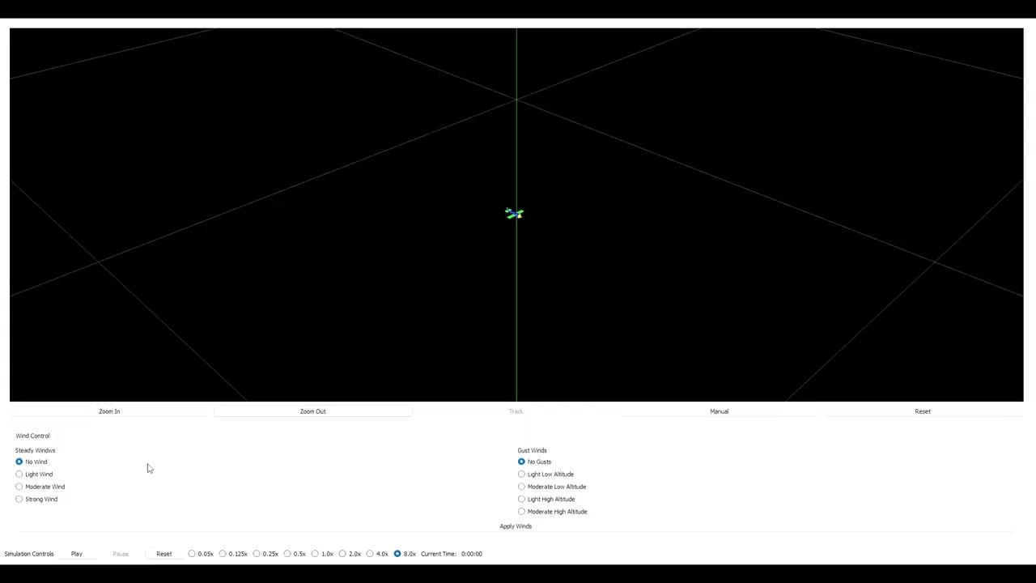
Results
ECE 263 - Final Project
Notes:
Connor

Slide 26
Conclusions
Successes
UAV clearly goes from waypoint to waypoint and orbits
We have both graphical and simulation demos
Failures
Bezier curves module does not work
Adding waypoints in the simulator is tedious
Entering a lower waypoint has weird effects
ECE 263 - Final Project
Notes:
Connor

Slide 27
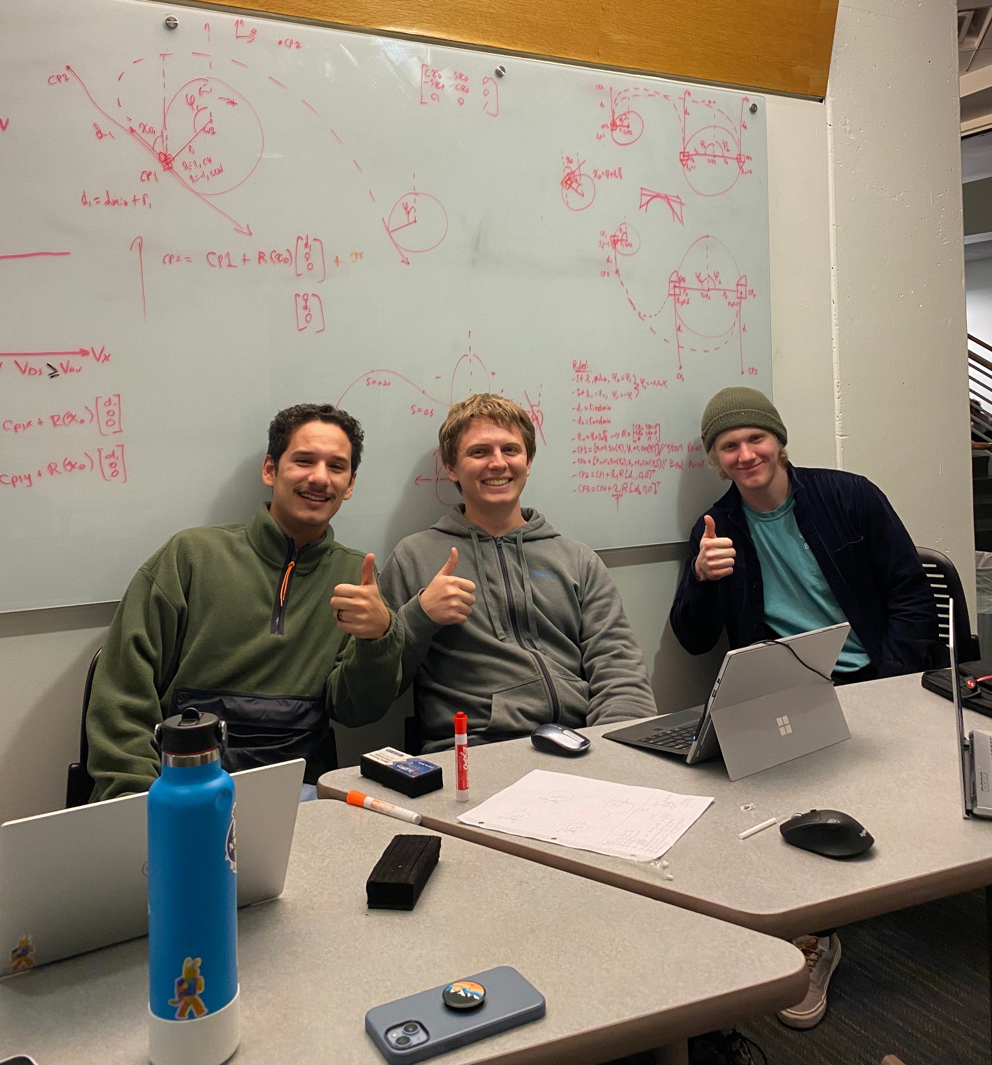
Conclusions
Divided Work
Bailen
Orbiting module
Bezier module
Miguel
Path following module
Waypoint module
Plotting demo
Connor
Path Following Module
Simulation demo/GUI hack
ECE 263 - Final Project

